Slide 1
Teaching High Emphasis/High Utility Content for the TASC Math Exam
February 8th, 2017 - 2:00PM - 3:30PM
Before we begin, please introduce yourself through the chat:
Note: You will probably want some paper and pencil for any calculations that may come up along the way. Calculators are allowed. 😊
Your name, role, program, region
What is one thing you hope to get out of today’s webinar?
Note: If you don’t have audio through your computer, you can connect to the webinar through your phone. Dial (515) 739-1030 and enter access code 577-791-372.

Slide 2
Notes about this webinar
All participants have been muted. We do want your participation, though! Please write ideas, questions, comments in the chat box throughout the webinar. Panelists will respond to questions during the Q&A sections of today’s session.
If you have a technical question or problem, please send a private chat message to Eric.
The webinar will be recorded and available at CollectEdNY.org.

Slide 3
Goals
Connect adult education math teachers with representatives from DRC and NYSED
We hope teachers will leave with a better understanding of:
how to narrow the scope of what they teach and focus on high-utility/high emphasis math content
the kinds of questions students may be asked on the TASC
available teaching materials

Slide 4
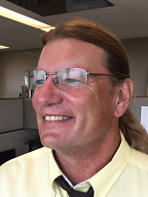
Today’s Presenters
Eric Appleton, Math & Science Professional Developer, CUNY Adult Literacy/HSE Program
Deedra Arvin, Test Development Program Manager, Data Recognition Corporation | CTB
Tim Jones, Associate for Instructional Services, New York State Education Department
Mark Trushkowsky, Math Professional Development Coordinator, CUNY Adult Literacy/HSE Program

Slide 5
Agenda
Launch: Notice/Wonder
The Many Faces of a TASC Math Problem
TASC Math Blueprint & Item Specifications
Changes to the TASC Math Reference Sheet
Q & A
Feedback

Slide 6
I Notice… I Wonder...

Slide 7
Four friends used the same taxi service to meet at a restaurant for dinner.
Passenger | Distance (in miles) | Cost
Denise | 1 | $4.50
Mark | 6 | $12
Solange | 3 | $7.50
Kate | 8 | $15
What math questions could you ask?
What do you notice?
What do you wonder?

Slide 8
Four friends used the same taxi service to meet at a restaurant for dinner. When they arrived at the restaurant, they compared their cab fare and tried to figure out a rule that the taxi company used to calculate cost.
Passenger | Distance (in miles) | Cost
Denise | 1 | $4.50
Mark | 6 | $12
Solange | 3 | $7.50
Kate | 8 | $15
Which linear function models the relationship between the number of miles driven, m, and the cost of the cab ride, C?
C = 4.5m
C = 2.5m
C = 1.5m + 3
C = 3m + 1.50
Notes:
A.CED.2: Create equations in two or more variables to represent relationships between quantities; graph equations on coordinate axes with labels and scales.

Slide 9
Four friends used the same taxi service to meet at a restaurant for dinner. When they arrived at the restaurant, they compared their cab fare and tried to figure out a rule that the taxi company used to calculate cost.
Passenger | Distance (in miles) | Cost
Denise | 1 | $4.50
Mark | 6 | $12
Solange | 3 | $7.50
Kate | 8 | $15
Which linear function models the relationship between the number of miles driven, m, and the cost of the cab ride, C(m)?
C(m) = 4.5m
C(m) = 2.5m
C(m) = 1.5m + 3
C(m) = 3m + 1.50

Slide 10
c = 1.5m + 3
c = 1.5(6) + 3
c = 9 + 3
c = 12
c(m) = 1.5m + 3
c(6) = 1.5(6) + 3
c(6) = 12

Slide 11
Four friends used the same taxi service to meet at a restaurant for dinner. When they arrived at the restaurant, they compared their cab fare and tried to figure out a rule that the taxi company used to calculate cost.
Passenger | Distance (in miles) | Cost
Denise | 1 | $4.50
Mark | 6 | $12
Solange | 3 | $7.50
Kate | 8 | $15
Which statement is true about the cab fare?
The ride costs $4.50 for each mile.
The ride costs $3.00 for each mile driven plus $1.50
For each 10 miles driven, the cab ride costs $18.00
The ride costs $1.50 for each mile plus a flat fee of $3.00

Slide 12
Four friends used the same taxi service to meet at a restaurant for dinner. When they arrived at the restaurant, they compared their cab fare and figured out they could calculate the cost of a ride using the following function: C = 1.5m + 3, where m is the number of miles traveled and C is the cost of the ride.
Passenger | Distance (in miles) | Cost
Denise | 1 | $4.50
Mark | 6 | $12
Solange | 3 | $7.50
Kate | 8 | $15
Halfway through the meal, the group’s friend, Isabel, arrives. Isabel who also used the same taxi service, paid $22.50 for the ride. What distance did she travel?

Slide 13
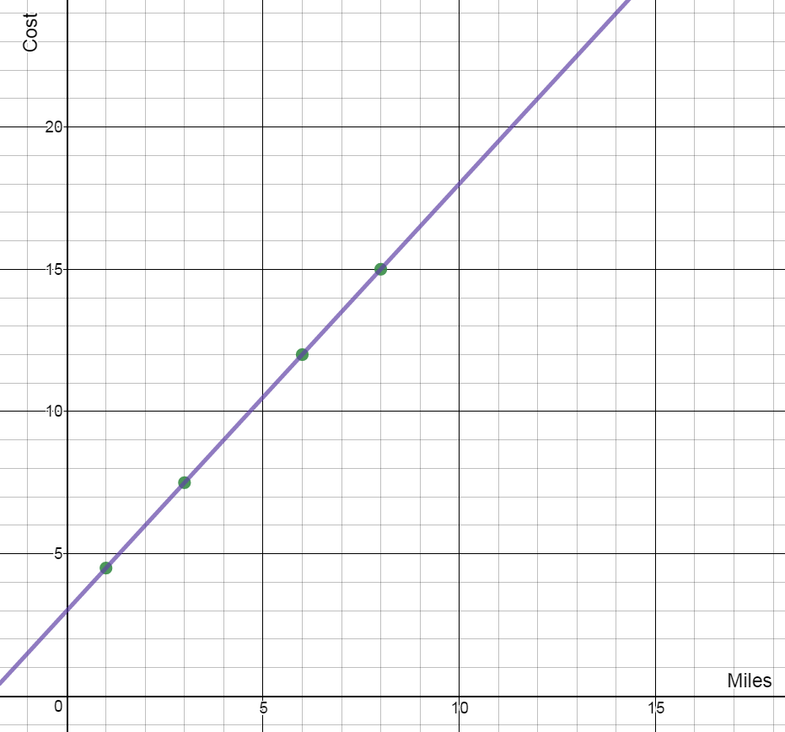
Four friends used the same taxi service to meet at a restaurant for dinner. The graph to the right shows the distance traveled, in miles, and the cost of each friends’ ride.
How much would it cost to ride for 10 miles?
If C is the cost of a ride that is m miles, which function can be used to calculate the cost of a taxi ride?
C = 4.5m
C = 2.5m
C = 1.5m + 3
C = 3m + 1.50
Notes:
Draw the line, remove the starting amount
Rate of change/starting amount versus
Science/Social studies - graphs
Plotting on a graph

Slide 14
TASC Blueprint and
Item Specifications
What is covered on the TASC math test?
How can teachers use the item specifications to prepare for instruction?

Slide 15
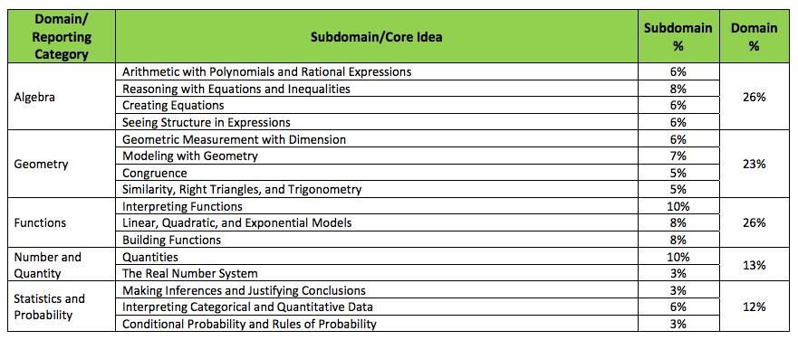
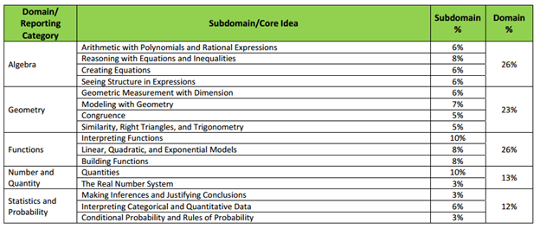
TASC Math Blueprint
Notes:
To mention:
52% Functions and Algebra - What would you say to teachers who say you have to wait until students have mastered all of the basics before moving into functions and algebra?
Trig.
About half in the items on the readiness test (forms 4 and 5) are in a context.
Workforce (14) - linear and exponential functions, systems of equations, systems of inequalities, reading line graphs, rate of change, starting amount, creating equations, interpreting functions, percentage, percent increase, reading function tables, charts, probability
It seems like there is a high-emphasis placed on students being able to connect real-world situations with functions, equations and graphs and vice-versa. Students have to be able to recognize different ways to represent a situation. They also need to be able to understand how the different elements of the function/equation connect to the real-world situation.
Science (1) - bacteria, exponential growth, percent change (earlier tests had things like Newton’s laws)
Social studies (2) - population density
Personal finance (2) - savings accounts
The graphs, data, charts in social studies (and science) sections
Line graphs, line of best fit, charts, interpreting data, using formula, pie charts, pictograph, and an equilibrium price graph. Note that there is more data and statistics than the blueprint would suggest because it is found in the science and social studies sections. When possible, math teachers should confer with reading/writing teachers to look for opportunities to integrate math into other disciplines, especially through the use of data, charts, and graphs.

Slide 16
TASC ASSESSMENT STANDARDS
TASC Math Item Specifications
http://www.acces.nysed.gov/common/acces/files/hse/tasc_2016_item_specifications_mathematics_may2016.pdf
Notes:
Page 13 - Explain each step in solving a simple equation as following from the equality of numbers asserted at the previous step, starting from the assumption that the original equation has a solution. Construct a viable argument to justify a solution method.
What kinds of equations would students have to solve (top end of solving equations)
Not just solve, but know why you are allow
Close reading - following
Page 23 - Interpret expressions that represent a quantity in terms of its context.
Is there a better example of a standards about what the variables mean in their context?
Unit 8 - Visual Patterns connections - start with understanding
P. 39 - where is the maximum/minimum here? Where are the zeros here?

Slide 17
TASC Reference Sheet
What can we learn from the changes to the TASC reference formula sheet?

Slide 18
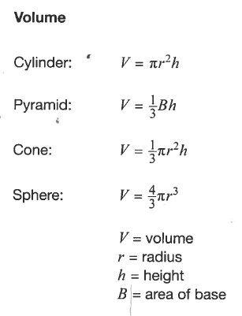
Geometry*
Standard: Use volume formulas for cylinders, pyramids, cones, and spheres to solve problems
Sample Item Stems:
Determine the volume of a cylinder with a radius of 3 inches and a height of 7 inches
How is the volume of a cone affected by doubling the height?
* from the TASC Math Item Specifications
Notes:
High Emphasis - Can you talk a bit about the emphasis on volume
Is student knowledge of area still assessed, even though there are no area formulas?
What kind of volume problems can students expect - only using the formulas?
Fractions Algebraic equations
(Pi)r squared
“How is the volume affected... “ sample item
Both math and science
Not many, these are higher end
Value to looking at equations

Slide 19
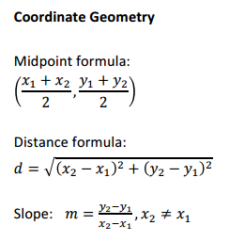
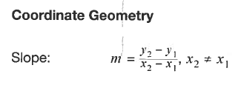
From this
to this

Slide 20
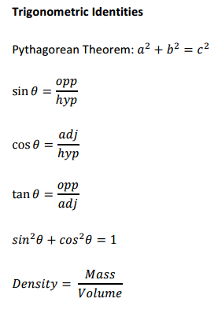
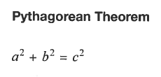
From this
to this

Slide 21
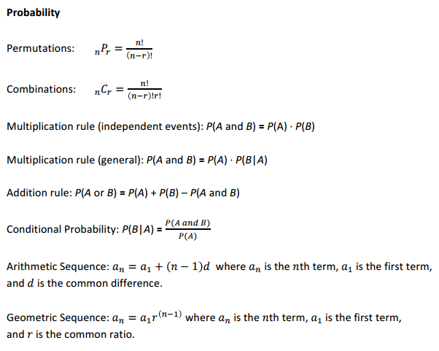
From this
to this

Slide 22
Contact Us:
Eric Appleton, CUNY, Science eric.appleton@cuny.edu
Deedra Arvin, DRC darvin@datarecognitioncorp.com
Kate Brandt, CUNY, ELA/SS kate.brandt@cuny.edu
Tim Jones, NYSED timothy.jones@nysed.gov
Mark Trushkowsky, CUNY, Math mark.trushkowsky@cuny.edu
Q&A: Questions from the Field
Feedback
Was this useful? How could it be improved?

Slide 23
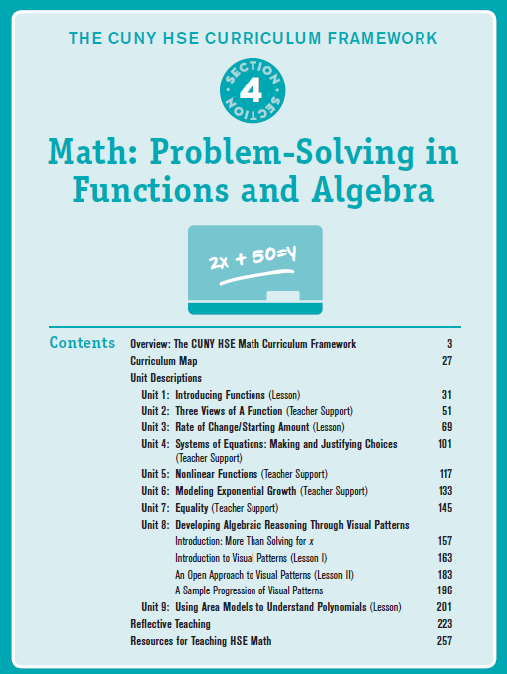
Teaching Resources
The CUNY HSE Curriculum Framework provides direction, structure and materials for teaching math, science and social studies (integrated with reading and writing) in the new era of HSE instruction.
The complete framework is available for free download at http://www.collectedny.org/2016/03/hseframework/
Notes:
Our students need extensive study in those areas of math. We sometimes hear from teachers that they teach operations with fractions, decimals and percent before introducing functions or algebra to students. However, students cannot wait to learn “the basics” first and then squeeze these high emphasis areas in at the end of a semester. It is possible to teach these fundamental subjects at the same time as functions. The CUNY HSE Math Curriculum Framework offers lessons and a scaffolded approach that allows students to develop a conceptual understanding of functions as well as learning the formal notation and contextualized applications.
You can find function activities emphasizing these real-world connections in the CUNY HSE Math Curriculum Framework

Slide 24
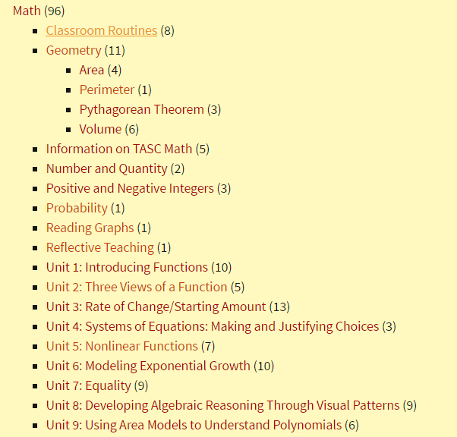
Teaching Resources
CUNY Framework Posts are supplemental activities focused on high-emphasis content on the TASC. Some extend the units in the framework as well as provide additional support and practice to students wherever they need it. Framework Posts also has teaching materials for topics not covered in the framework. www.collectedny.org/frameworkposts

Slide 25
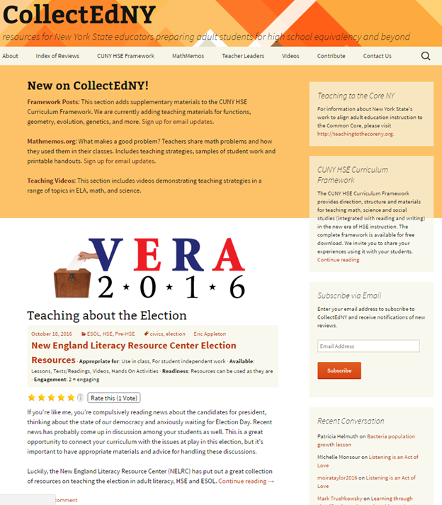
Teaching Resources
CollectEdNY features reviews of high-quality, free teaching resources, including lesson plans, videos, activities, and more. The reviews are written by adult education teachers with adult education students and classrooms in mind. Each review describes the resource and offers advice for how to get started.
www.CollectEDNY.org

Slide 26
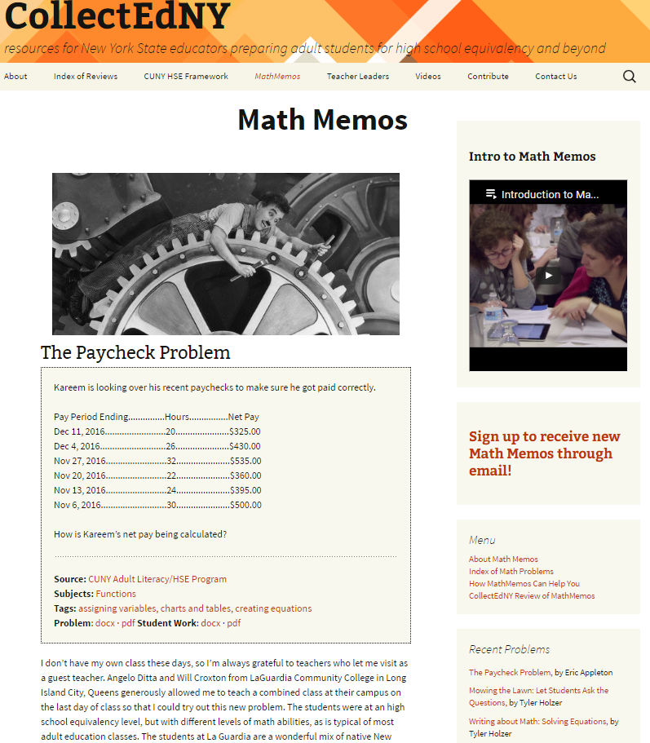
Teaching Resources
MathMemos is a math teacher space within CollectEdNY where adult educators share rich math problems across a wide range of content areas, as well as samples of student work, and practical suggestions for bringing the problems to life in the classroom. www.MathMemos.org

