Slide 1
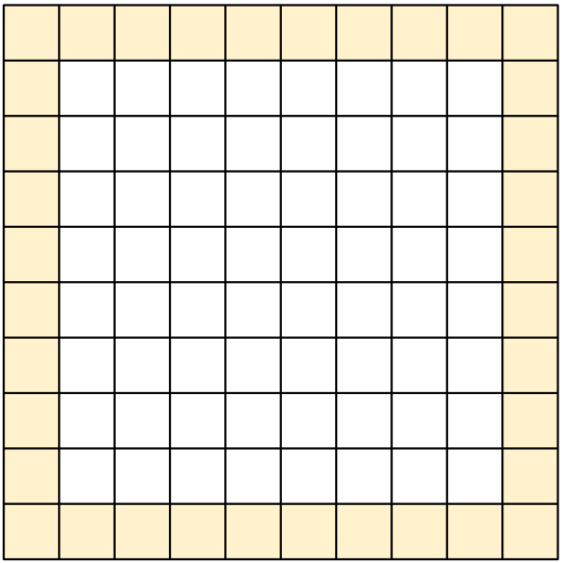
How many squares are in the border?
Notes:
Step 1: Put on student hats. Without counting one-by-one, without speaking, and without writing anything down, come up with the number of squares that are in the blue border. (1 minute)
Step 2: Talk to a neighbor about how many squares are in the border and how you figured it out. Did they figure it out differently? (1-2 minutes)
Step 3: Share out.(Ask participants to share out how they figured it out with student hats still on, using numbers, addition, subtraction, multiplication, or division, no variables, or parenthesis.) Write down on one side of a piece of chart paper all ways participants saw (or students might compute) the border (on the other side we will translate these to algebraic equations). There are six different combinations (that I know of):
10 x 4 - 4 = 36
10 + 9 + 9 + 8 = 36
4 x 9 = 36
100 - 64 = 36 (This method requires understanding of area.)
10 + 10 + 8 + 8 = 36
4 x 8 + 4 = 36
If one or more of these combinations is not shared out, write the combination on the chart paper and ask participants, “If I write this, what am I thinking?”

Slide 2
Share Your Way of Counting
One student at a time, explain how you counted. Come to the board if it’s helpful. Does everyone else understand?
Does someone else have another way?
Are there any other possible ways to count the border squares? Show us.
Notes:
Before going over step 1, ask for a working definition of a square. How is that different from a rectangle. Is a square a rectangle?
Be sure when reading step 1 say: 3 x 3 or 4 x 4 up to 12 x 12 to make explicit what a square is. (This is needed for students)

Slide 3
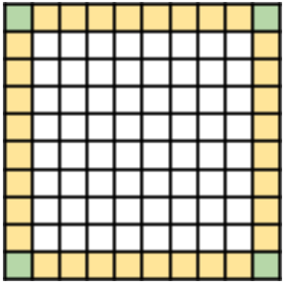
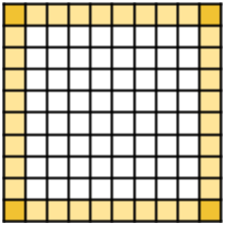
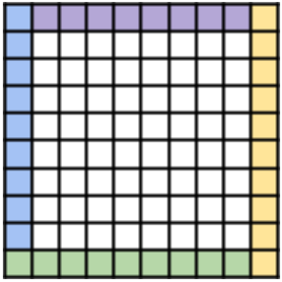
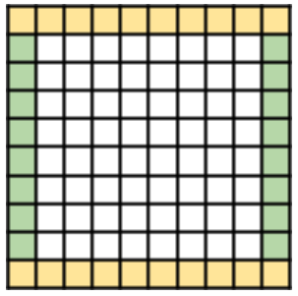
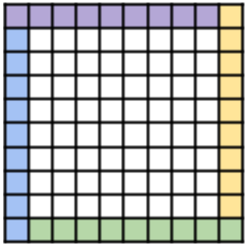
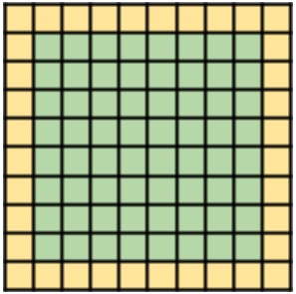
Ways of Seeing
4 x 8 + 4 = 36
10 x 4 - 4 = 36
10 + 9 + 9 + 8 = 36
10 + 10 + 8 + 8 = 36
4 x 9 = 36
100 - 64 = 36

Slide 4
Try this!
Choose a method ...
Draw a square that is 6 units on one edge.
Figure the number of unit squares that make up the border of your square.
Notes:
Before going over step 1, ask for a working definition of a square. How is that different from a rectangle. Is a square a rectangle?
Be sure when reading step 1 say: 3 x 3 or 4 x 4 up to 12 x 12 to make explicit what a square is. (This is needed for students)

Slide 5
Try this!
Choose a method ...
Draw a square that is 6 units on one edge.
Figure the number of unit squares that make up the border of your square.
Notes:
Before going over step 1, ask for a working definition of a square. How is that different from a rectangle. Is a square a rectangle?
Be sure when reading step 1 say: 3 x 3 or 4 x 4 up to 12 x 12 to make explicit what a square is. (This is needed for students)

Slide 6
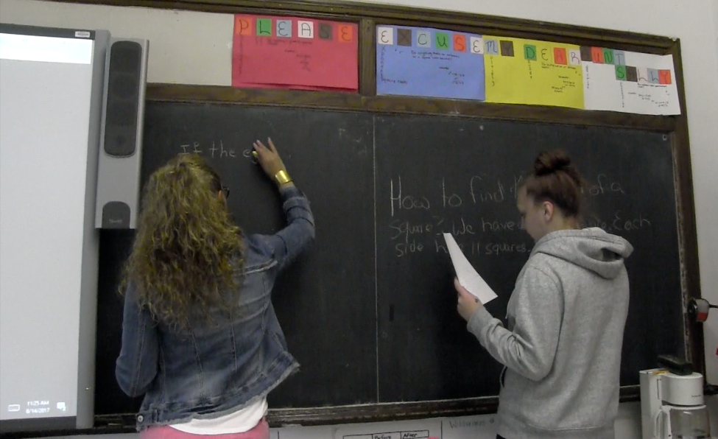
Writing
Write a description so that someone who wasn’t here in class today would have a way to find the number of squares on the border of any size square grid. Be sure to explain why the method works.
Notes:
ELL, ABE, and HSE students all participated in this lesson. I walked around as students were writing their explanations and asked two of the students, one and ELL student and one a student who was nearing readiness to take the HSE exam to write their explanations on the board. Highlights that students at all levels can participate in this activity.
The next slide is an example of a written description that I collected from one of the students.

Slide 7
Push Questions
What is the perimeter of a square that has a border of 52 squares?
If the total number of squares on the border is 64, how many squares are on one edge?

Slide 8
Equations
Can you write an equation for finding b, the number of squares in the border, of an sxs sized grid?

