Slide 1
Exploring the TASC Science Item Specifications
July 11th, 2016
#CUNYHSE
While we’re waiting to begin, please introduce yourself through the chat:
Name, role, program, region
What is one thing you hope to get out of today’s webinar?
If you don’t have audio through your computer, you can connect to the webinar through your phone. Dial (605) 562-0020 and enter access code 577-791-372.

Slide 2
Notes about this webinar
All participants have been muted.
If you have a technical question or problem, please send a private chat message to Eric.
If you have any questions you would like us to address, please post them in the chat box at any point during our presentations. Mark will be monitoring these questions and panelists will respond during the Q&A sections of today’s session.

Slide 3
Goals
We hope that teachers will leave with:
An understanding of the TASC item specifications documents
An understanding of the content emphasized in LS1-4 (cellular division)
Some ideas for exploring the item specifications document and other resources related to content on the TASC science test

Slide 4
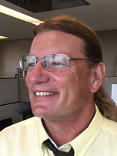
Today’s Presenters
Eric Appleton, Math & Science Professional Developer, CUNY Adult Literacy/HSE Program
Deedra Arvin, Test Development Program Manager, Data Recognition Corporation | CTB
Kate Brandt, ELA Professional Developer, CUNY Adult Literacy/HSE Program
Tim Jones, Associate for Instructional Services, New York State Education Department
Mark Trushkowsky, Math Professional Developer, CUNY Adult Literacy/HSE Program

Slide 5
Agenda
Launch
Evidence Statements for LS1-4 (cellular division)
Q&A
Overview of the TASC blueprints and item specifications
Q&A
Feedback

Slide 6
Prediction Guide
Read each statement and decide whether you think it’s true or false.
The cell is the basic unit of life.
All organisms are made up of multiple cells.
Cells got their name because they looked like small rooms.
All animal cells look about the same.
Cell division happens only when an organism is growing.

Slide 7
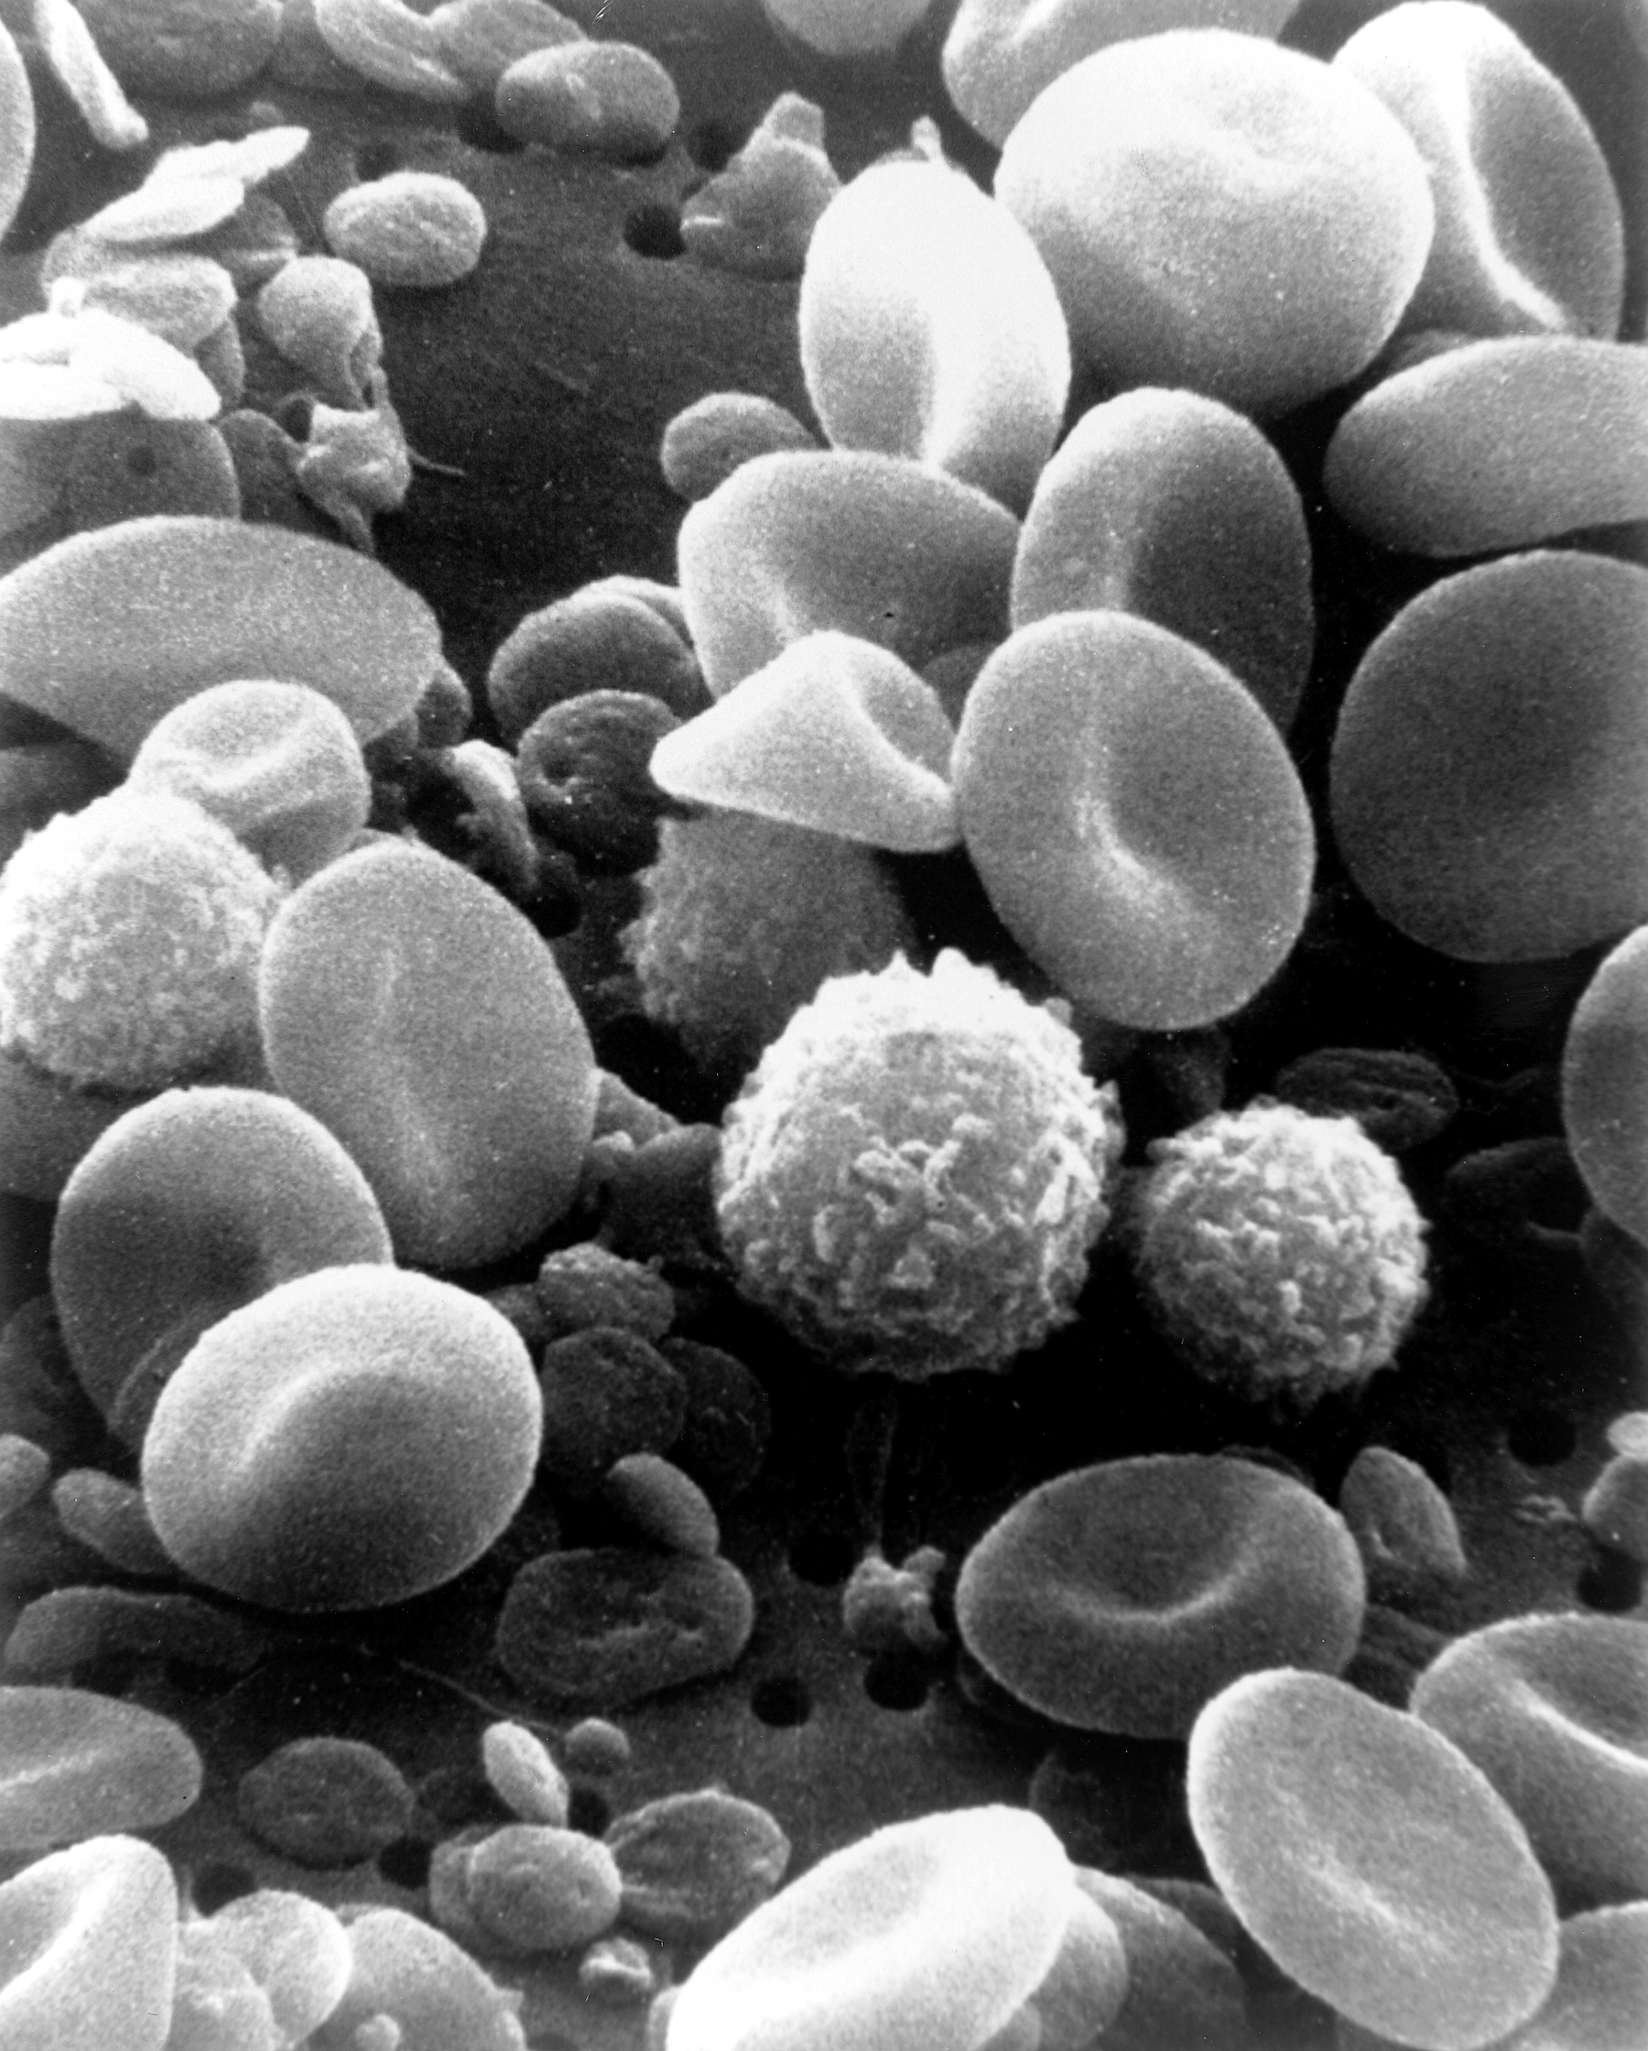
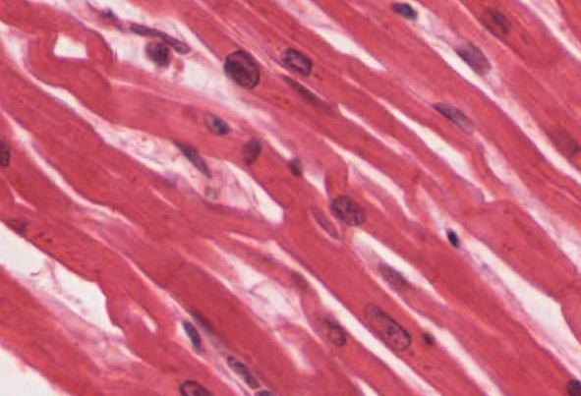
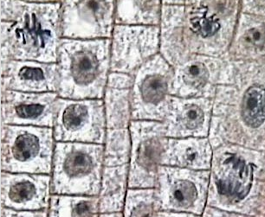
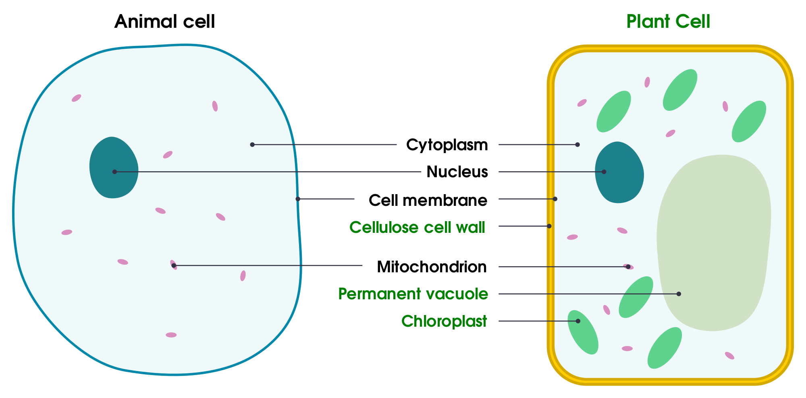
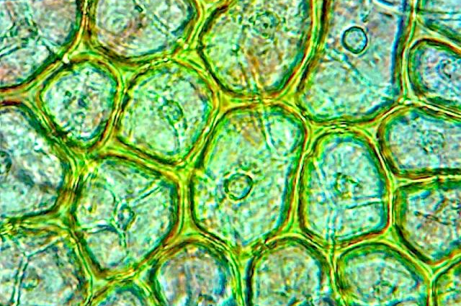
What do you notice?
What do you wonder?
blood cells
heart muscle
onion cells
A
B
C
tomato skin cells
D
Images courtesy of Wikipedia Commons & https://lima.osu.edu

Slide 8
How do these statements connect to the images we just looked at?
The examinee will demonstrate understanding that...
The cell is a basic unit of structure and function of living things (cell theory).
For all living things, life activities are accomplished at the cellular level.
Some organisms are single-celled; others, including humans, are multicellular.
The way in which cells function is similar in all living things.

Slide 9
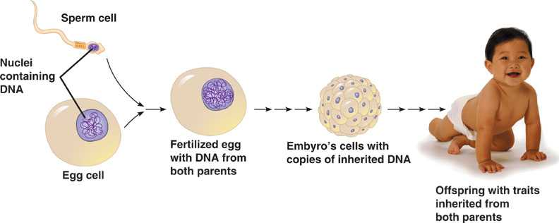
How do we go from one cell to a baby?
Image courtesy of http://www.slideshare.net/mpattani/biology-in-focus-chapter-1

Slide 10
How do these statements connect to the diagram we just looked at?
The examinee will demonstrate understanding that...
Zygotes contain all of the information necessary for growth, development, and eventual reproduction of the organism.
Development is a highly regulated process involving mitosis and differentiation.
In multicellular organisms, cell division is responsible for growth, maintenance, and repair.
In one type of cell division, mitosis, chromosomes are duplicated and then separated into two identical and complete sets to be passed to each of the two resulting cells. In mitosis, the hereditary information is identical in all of the cells that result.
The many body cells in an individual can be very different from one another, even though they are all descended from a single cell and thus have essentially identical genetic instructions because different parts of the genetic instructions are used in different types of cells and are influenced by the cell’s environment and past history.

Slide 11
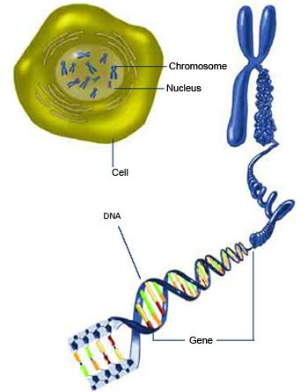

Slide 12
Q&A
What questions do you have about any of the content we’ve just looked at?
Prediction Guide
Read each statement and decide whether you think it’s true or false.
The cell is the basic unit of life. T
All organisms are made up of multiple cells. F
Cells got their name because they looked like small rooms. T
All animal cells look about the same. F
Cell division happens only when an organism is growing. F

Slide 13
The TASC Item Specifications
What is covered in the TASC Science Test?
How are the specifications used in the test development process?
How can teachers use the item specifications to prepare for instruction?

Slide 14
Q&A
What questions do you have about the item specifications or the TASC Science test in general?

Slide 15
Resources
CollectEdNY.org http://collectedny.org - recording of this webinar
TASC Item Specifications http://www.acces.nysed.gov/hse/tasc-test-and-item-specifications
TASC Blueprints http://www.tasctest.com/resources.html
Next Generation Science Standards http://www.nextgenscience.org
A Framework for K-12 Science Education http://www.nap.edu/read/13165
Past Regents Examinations http://www.nysedregents.org
Learn.Genetics http://learn.genetics.utah.edu

Slide 16
Feedback
Next Steps
Contact Us:
Eric Appleton, CUNY eric.appleton@cuny.edu
Deedra Arvin, DRC darvin@datarecognitioncorp.com
Kate Brandt, CUNY kate.brandt@cuny.edu
Tim Jones, NYSED timothy.jones@nysed.gov
Mark Trushkowsky, CUNY mark.trushkowsky@cuny.edu
Was this useful? How could it be improved? Should we do more webinars?
Teaching ideas for the Item Specs: https://goo.gl/M8jcuX

